Slide 1
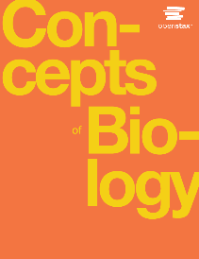
Concepts of Biology
Chapter 7 THE CELLULAR BASIS OF INHERITANCE
PowerPoint Image Slideshow

Slide 2
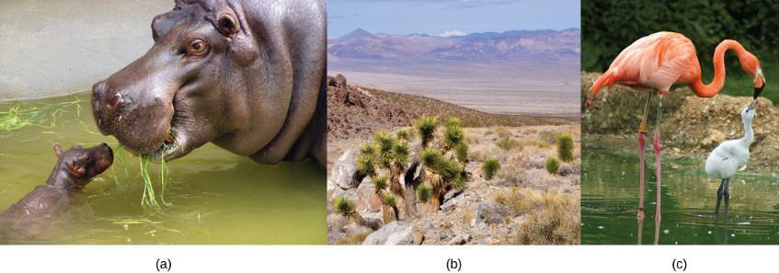
Intro: Figure 7.1
Each of us, like these other large multicellular organisms, begins life as a fertilized egg. After trillions of cell divisions, each of us develops into a complex, multicellular organism.
(credit a: modification of work by Frank Wouters; credit b: modification of work by Ken Cole, USGS; credit c: modification of work by Martin Pettitt)
This OpenStax ancillary resource is © Rice University under a CC-BY 4.0 International license; it may be reproduced or modified but must be attributed to OpenStax, Rice University and any changes must be noted. Any images credited to other sources are similarly available for reproduction, but must be attributed to their sources.
Notes:
The ability to reproduce in kind is a basic characteristic of all living things. In kind means that the offspring of any organism closely resembles its parent or parents.
Sexual reproduction is the production by parents of haploid cells and the fusion of a haploid cell from each parent to form a single, unique diploid cell. In multicellular organisms, the new diploid cell will then undergo mitotic cell divisions to develop into an adult organism. A type of cell division called meiosis leads to the haploid cells that are part of the sexual reproductive cycle.

Slide 3
Learning Objectives
• Explain that variation among offspring is a potential evolutionary advantage resulting from sexual reproduction
• List the three different life-cycle strategies among sexual multicellular organisms
• Describe the behavior of chromosomes during meiosis
• Describe cellular events during meiosis
• Explain the differences between meiosis and mitosis
• Explain the mechanisms within meiosis that generate genetic variation among the products of meiosis
• Explain how nondisjunction leads to disorders in chromosome number
• Describe how errors in chromosome structure occur through inversions and translocations

Slide 4
Reproduction: Intro
Asexual reproduction:
All in population are female so all can reproduce (competitive advantage)
Energy not spent on attracting mate
Sexual reproduction:
Used by multicellular organisms
Possibly preferred due to introduction of variation among offspring
Meiosis is the division of the contents of the nucleus that divides the chromosomes among gametes.
Variation is introduced during meiosis, as well as when the gametes combine in fertilization.

Slide 5
Terminology
Somatic cells: the nonreproductive cells of a multicellular organism
Diploid: cells containing two sets of chromosomes (2n)
Most animal and plant cells
Haploid: cells containing one set of chromosomes (n)
Diploid somatic cells contain two copies of each chromosome referred to as homologous chromosomes. Diploid organisms inherit one copy of each homologous chromosome from each parent.
Fertilization: the union of two cells from two individual organisms
Required for sexual reproduction
Requires meiosis to reduce the number of chromosome sets
Notes:
In animals, haploid cells containing a single copy of each homologous chromosome are found only within gametes. Gametes fuse with another haploid gamete to produce a diploid cell.

Slide 6
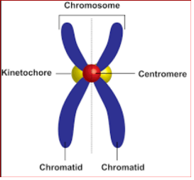
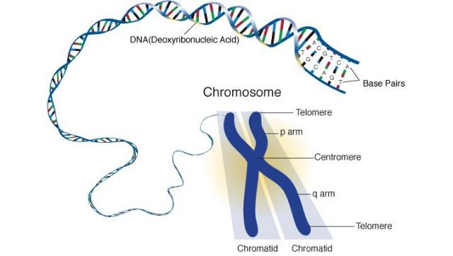
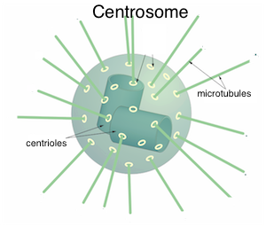
Chromosomes
Centromere: region in middle of chromosome for attachment to spindle microtubules via kinetochore
Kinetochore: a protein structure in the centromere of each sister chromatid that attracts and binds spindle microtubules during prometaphase
Centrosome: microtubule-organizing center, contains pair of centrioles
Centriole: a paired rod-like structure constructed of microtubules at the center of each animal cell centrosome
Photo credit: https://www.healio.com/hematology-oncology/learn-genomics/genomics-primer/what-are-chromosomes
https://digital.aakash.ac.in/aakashassist/#/student/answer/328126-in-diagram-of-chrosome-what-do-we-see-2-kinetochores-or-1-kinetochore-n-1-centromere
https://www.toppr.com/ask/content/concept/centromeres-centrosomes-and-centrioles-200297/
Notes:
Centrosome: Unspecified role in cell division in animal cells; organizing center of microtubules in animal cells

Slide 7
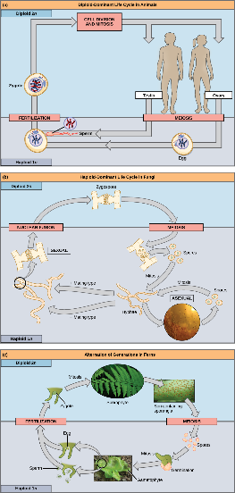
Life Cycles in Sexual Reproduction: Figure 7.2
Across living organisms, there are a variety of life cycle patterns. We will focus on animals which undergo sexual reproduction (a). This means they will use meiosis to make haploid gametes then two gametes will fuse to make a diploid offspring.
Diploid-dominant: animals
Haploid-dominant: Fungi
Alternating generations: plants (life cycle alternates between a multicellular haploid organism and a multicellular diploid organism)
(credit c “fern”: modification of work by Cory Zanker; credit c “gametophyte”: modification of work by “Vlmastra”/Wikimedia Commons)
This OpenStax ancillary resource is © Rice University under a CC-BY 4.0 International license; it may be reproduced or modified but must be attributed to OpenStax, Rice University and any changes must be noted. Any images credited to other sources are similarly available for reproduction, but must be attributed to their sources.
Notes:
The gametes are produced from diploid germ cells, a special cell line that only produces gametes. Once the haploid gametes are formed, they lose the ability to divide again. There is no multicellular haploid life stage. Fertilization occurs with the fusion of two gametes, usually from different individuals, restoring the diploid state
Most fungi and algae employ a life-cycle strategy in which the multicellular “body” of the organism is haploid. During sexual reproduction, specialized haploid cells from two individuals join to form a diploid zygote. The zygote immediately undergoes meiosis to form four haploid cells called spores
These species have both haploid and diploid multicellular organisms as part of their life cycle. some algae and all plants

Slide 8
Meiosis
Meiosis consists of one round of chromosome duplication and two rounds of nuclear division
Starting nucleus: diploid (2n)
Ending nuclei: haploid (n)
Interphase occurs before meiosis: G1, S, and G2 nearly identical to the phases preceding mitosis.
Meiosis I: first round of meiotic division
Reduces chromosome sets from two to one
Genetic information mixed to create unique recombinant chromosomes
Meiosis II: second round of meiotic division
End with 4 haploid cells
Notes:
S phase: each chromosome becomes composed of two identical copies (called sister chromatids)
Great summary: https://www.khanacademy.org/science/ap-biology/heredity/meiosis-and-genetic-diversity/a/phases-of-meiosis

Slide 9
Meiosis I
Prophase I: chromosomes condense and align in homologous pairs
Crossing over: homologous chromosomes can trade parts
(Chiasmata: the structure that forms at the crossover points after genetic material is exchanged)
Metaphase I: homologous chromosomes (the pair) line up in the middle (metaphase plate)
Independent assortment: orientation of each pair of homologous chromosomes at the center of the cell is random
Anaphase I: homologous chromosomes separate
Note: sister chromatids stay together (unlike mitosis)
Telophase I: separated chromosomes arrive at opposite poles
Then Cytokinesis: the physical separation of the cytoplasmic components into two daughter cells that are haploid (n)
Notes:
variation in the daughter nuclei is introduced because of crossover in prophase I and random alignment at metaphase I

Slide 10
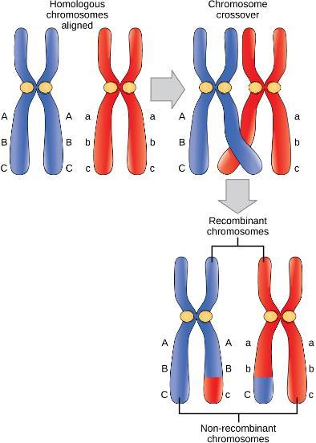
Crossing Over: Figure 7.3
The blue chromosome came from the individual’s father and the red chromosome came from the individual’s mother.
Crossing over occurs between non-sister chromatids of homologous chromosomes. The result is an exchange of genetic material between homologous chromosomes.
The chromosomes that have a mixture of maternal and paternal sequence are called recombinant and the chromosomes that are completely paternal or maternal are called non-recombinant.
This OpenStax ancillary resource is © Rice University under a CC-BY 4.0 International license; it may be reproduced or modified but must be attributed to OpenStax, Rice University and any changes must be noted. Any images credited to other sources are similarly available for reproduction, but must be attributed to their sources.
Notes:
variation in the daughter nuclei is introduced because of crossover in prophase I and random alignment at metaphase I

Slide 11
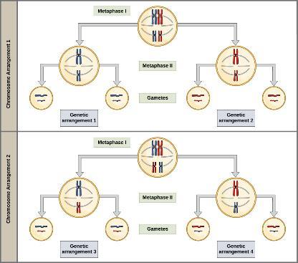
Independent Assortment: Figure 7.4
To demonstrate random, independent assortment at metaphase I, consider a cell with n = 2. In this case, there are two possible arrangements at the equatorial plane in metaphase I, as shown in the upper cell of each panel.
These two possible orientations lead to the production of genetically different gametes.
With more chromosomes, the number of possible arrangements increases dramatically.
it is highly unlikely that any two haploid cells resulting from meiosis will have the same genetic composition
This OpenStax ancillary resource is © Rice University under a CC-BY 4.0 International license; it may be reproduced or modified but must be attributed to OpenStax, Rice University and any changes must be noted. Any images credited to other sources are similarly available for reproduction, but must be attributed to their sources.
Notes:
There are two possibilities for orientation (for each tetrad); thus, the possible number of alignments equals 2^n where n is the number of chromosomes per set. Humans have 23 chromosome pairs, which results in over eight million (2^23) possibilities. This number does not include the variability previously created in the sister chromatids by crossover.

Slide 12
Meiosis II
Big picture: the connected sister chromatids remaining in the haploid cells from meiosis I will be split to form four haploid cells.
Prophase II: chromosomes condense and new spindle fibers form
Metaphase II: sister chromatids are maximally condensed and aligned at the center of the cell
Anaphase II: sister chromatids are pulled apart by the spindle fibers and move toward opposite poles
Telophase II: chromosomes arrive at opposite poles and begin to decondense
Then Cytokinesis: the physical separation of the cytoplasmic components into four genetically unique haploid cells (n)

Slide 13
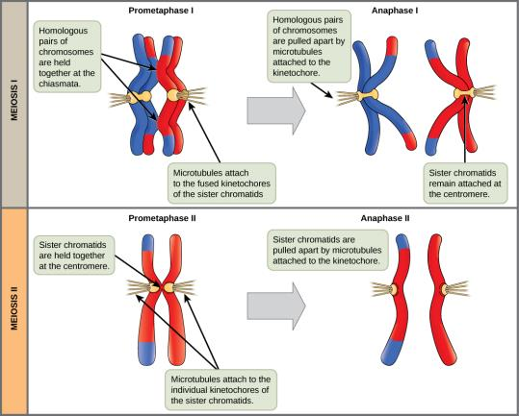
Late Prophase: Figure 7.5
In prophase I, microtubules attach to the fused kinetochores of homologous chromosomes. In anaphase I, the homologous chromosomes are separated.
In prophase II, microtubules attach to individual kinetochores of sister chromatids. In anaphase II, the sister chromatids are separated.
This OpenStax ancillary resource is © Rice University under a CC-BY 4.0 International license; it may be reproduced or modified but must be attributed to OpenStax, Rice University and any changes must be noted. Any images credited to other sources are similarly available for reproduction, but must be attributed to their sources.

Slide 14
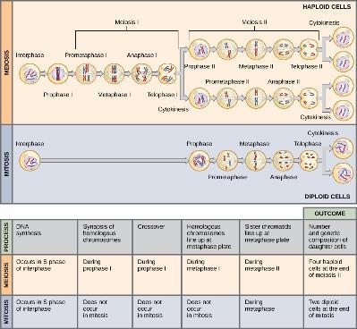
Meiosis & Mitosis: Figure 7.6
Meiosis and mitosis are both preceded by one round of DNA replication; however, meiosis includes two nuclear divisions.
The four daughter cells resulting from meiosis are haploid and genetically distinct. The daughter cells resulting from mitosis are diploid and identical to the parent cell.
This OpenStax ancillary resource is © Rice University under a CC-BY 4.0 International license; it may be reproduced or modified but must be attributed to OpenStax, Rice University and any changes must be noted. Any images credited to other sources are similarly available for reproduction, but must be attributed to their sources.
Notes:
Mitosis:
single nuclear division that results in two nuclei, usually partitioned into two new cells.
genetically identical nuclei to the original.
same number of sets of chromosomes: one in the case of haploid cells, and two in the case of diploid cells.
Meiosis:
two nuclear divisions that result in four nuclei, usually partitioned into four new cells.
nuclei never genetically identical
contain one chromosome set (n) only, half the number of the original cell (2n)
Meiosis I is a reduction division (the number of sets of chromosomes in each nucleus to-be is reduced from two to one)
Meiosis II is not a reduction division because, although there are fewer copies of the genome in the resulting cells, there is still one set of chromosomes, as there was at the end of meiosis I.
Cells produced by meiosis in a diploid-dominant organism such as an animal will only participate in sexual reproduction.

Slide 15
Meiosis & Mitosis: Figure 7.6
This OpenStax ancillary resource is © Rice University under a CC-BY 4.0 International license; it may be reproduced or modified but must be attributed to OpenStax, Rice University and any changes must be noted. Any images credited to other sources are similarly available for reproduction, but must be attributed to their sources.

Slide 16
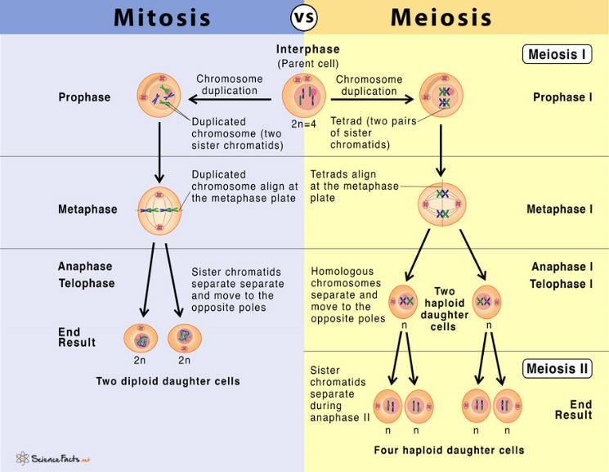
Another way of looking at it
Photo credit: https://www.sciencefacts.net/mitosis-vs-meiosis.html

Slide 17
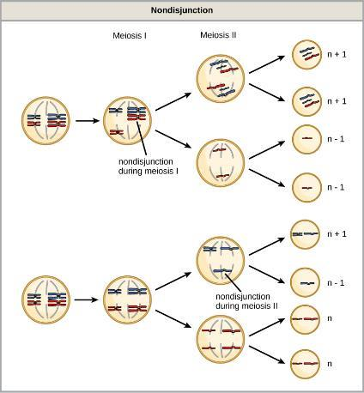
Nondisjunction: Figure 7.8
Following meiosis, each gamete has one copy of each chromosome.
Nondisjunction occurs when homologous chromosomes (meiosis I) or sister chromatids (meiosis II) fail to separate.
This OpenStax ancillary resource is © Rice University under a CC-BY 4.0 International license; it may be reproduced or modified but must be attributed to OpenStax, Rice University and any changes must be noted. Any images credited to other sources are similarly available for reproduction, but must be attributed to their sources.
Notes:
Nondisjunction: when pairs of homologous chromosomes or sister chromatids fail to separate during meiosis.
Meiosis I vs II (same as picture, just in words instead):
I = If homologous chromosomes fail to separate during meiosis I, the result is two gametes that lack that chromosome and two gametes with two copies of the chromosome.
II = If sister chromatids fail to separate during meiosis II, the result is one gamete that lacks that chromosome, two normal gametes with one copy of the chromosome, and one gamete with two copies of the chromosome

Slide 18
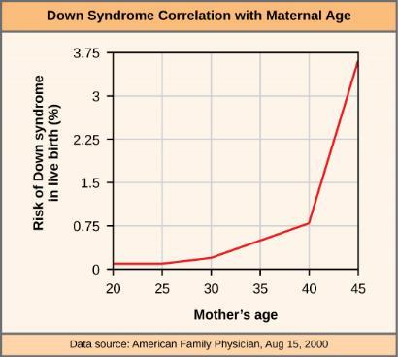
Nondisjunction: Figure 7.9
Euploid: an individual with the appropriate number of chromosomes for their species.
Aneuploid: an individual with an error in chromosome number
Monosomy: loss of one chromosome
Trisomy: gain of an extraneous chromosome
Typically don’t survive, but some with trisomy can
The incidence of having a fetus with trisomy 21 increases dramatically with maternal age.
This OpenStax ancillary resource is © Rice University under a CC-BY 4.0 International license; it may be reproduced or modified but must be attributed to OpenStax, Rice University and any changes must be noted. Any images credited to other sources are similarly available for reproduction, but must be attributed to their sources.

Slide 19
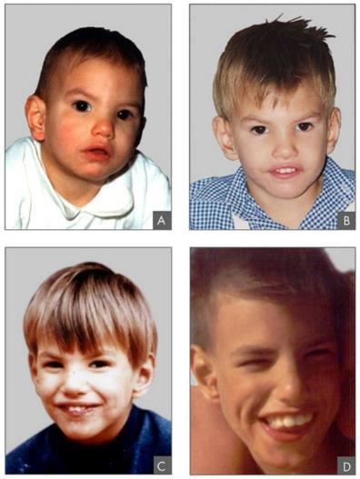
E.G. Figure 7.11
This individual with cri-du-chat syndrome (a deletion of most of the small arm of chromosome 5) is shown at various ages: (a) age two, (b) age four, (c) age nine, and (d) age 12.
(credit: Paola Cerruti Mainardi)
This OpenStax ancillary resource is © Rice University under a CC-BY 4.0 International license; it may be reproduced or modified but must be attributed to OpenStax, Rice University and any changes must be noted. Any images credited to other sources are similarly available for reproduction, but must be attributed to their sources.
Notes:
Duplications and deletions often produce offspring that survive but exhibit physical and mental abnormalities. Cri-du-chat (from the French for “cry of the cat”) is a syndrome associated with nervous system abnormalities and identifiable physical features that results from a deletion of most of the small arm of chromosome 5

Slide 20
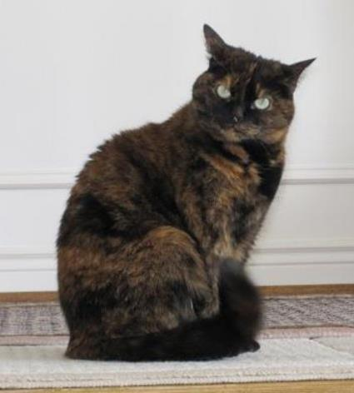
X Inactivation: Figure 7.10
Embryonic inactivation of one of two different X chromosomes encoding different coat colors gives rise to the tortoiseshell phenotype in cats.
(credit: Michael Bodega)
This OpenStax ancillary resource is © Rice University under a CC-BY 4.0 International license; it may be reproduced or modified but must be attributed to OpenStax, Rice University and any changes must be noted. Any images credited to other sources are similarly available for reproduction, but must be attributed to their sources.
Notes:
The important part of this: cells can inactivate chromosome so it isn’t expressed.
Females heterozygous for an X-linked coat color gene will express one of two different coat colors over different regions of their body, corresponding to whichever X chromosome is inactivated in the embryonic cell progenitor of that region. When you see a tortoiseshell cat, you will know that it has to be a female
Individuals with three X chromosomes, called triplo-X, appear female but express developmental delays and reduced fertility. The XXY chromosome complement, corresponding to one type of Klinefelter syndrome, corresponds to male individuals with small testes, enlarged breasts, and reduced body hair. The extra X chromosome undergoes inactivation to compensate for the excess genetic dosage. Turner syndrome, characterized as an X0 chromosome complement (i.e., only a single sex chromosome), corresponds to a female individual with short stature, webbed skin in the neck region, hearing and cardiac impairments, and sterility.

Slide 21
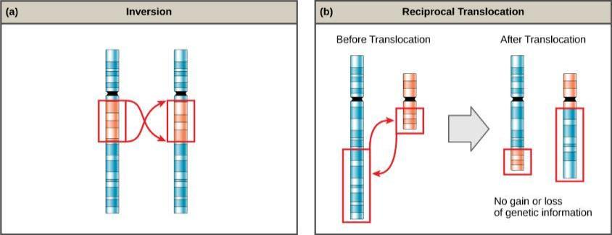
Inversion & Translocation: Figure 7.12
Errors in chromosome structure can occur.
(a) Inversion: a chromosome segment breaks, reverses its orientation, and then reattaches in the original position.
(b) Reciprocal translocation: occurs between two nonhomologous chromosomes and does not cause any genetic information to be lost or duplicated.
(credit: modification of work by National Human Genome Research Institute (USA))
This OpenStax ancillary resource is © Rice University under a CC-BY 4.0 International license; it may be reproduced or modified but must be attributed to OpenStax, Rice University and any changes must be noted. Any images credited to other sources are similarly available for reproduction, but must be attributed to their sources.
Notes:
A chromosome inversion is the detachment, 180° rotation, and reinsertion of part of a chromosome.
Unless they disrupt a gene sequence, inversions only change the orientation of genes and are likely to have more mild effects than aneuploid errors.
Translocations can be benign or have devastating effects, depending on how the positions of genes are altered with respect to regulatory sequences.

